Slide 1
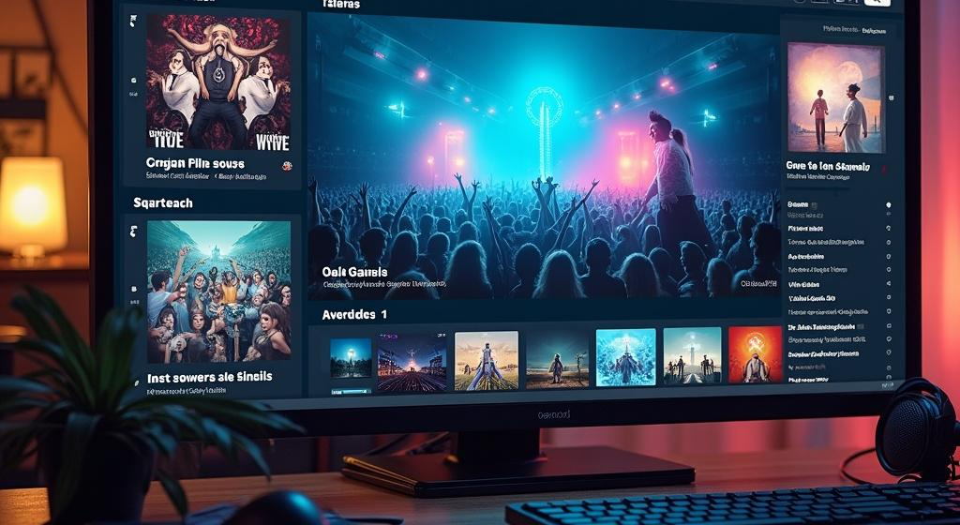
Music Group Website
SYED HASSAN ALI
MUHAMMAD RAZA SARDAR
AYAAN KASHIF
MUHAMMAD ALI

Slide 2
Introduction
This presentation outlines the key features and functionalities of the new music group's website, focusing on the song video player and album promotion.

Slide 3
Purpose and Goals
The primary purpose of the website is to create an engaging platform for fans to explore music content, access artist information, and enhance user interactions with a song video player. The goals include increasing fan engagement, promoting new releases, and providing a seamless experience for viewing music videos and album artwork.

Slide 4
Target Audience
The target audience includes music fans of various demographics, ranging from casual listeners to dedicated followers of the group. This includes individuals aged 15-40 who are tech-savvy and consume music online. The website aims to cater to both new visitors seeking information and existing fans looking for updates and exclusive content.

Slide 5
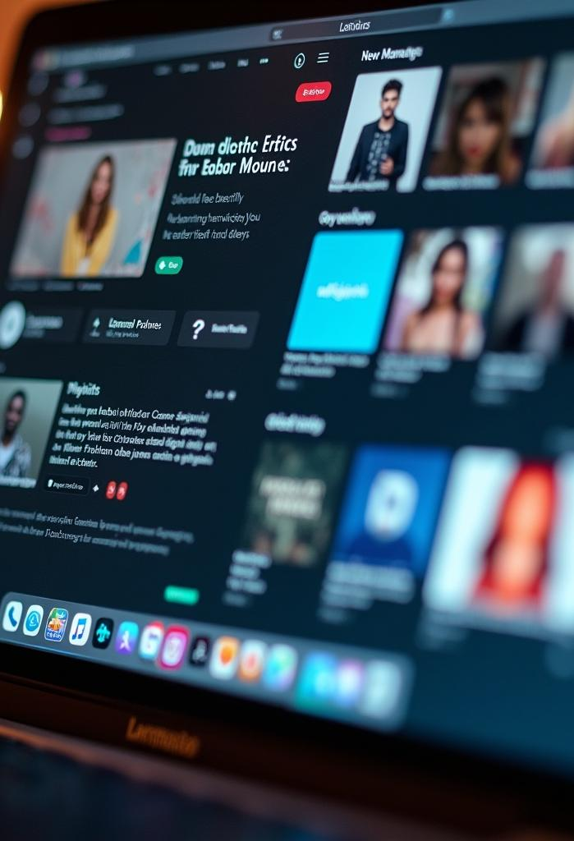
Features and Functionality
The website will feature an intuitive layout that allows users to navigate easily between different sections. Key functionalities include a dedicated song video player that showcases music videos, a section for exploring artist profiles, and easy access to the latest albums and releases. Users can also create personalized playlists and interact with content through comments or shares.

Slide 6
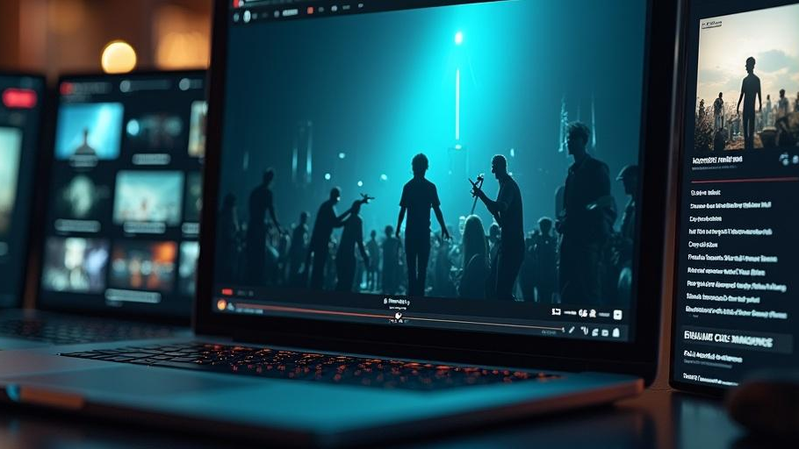
Song Video Player
02

Slide 7
Design and User Experience
The song video player will have a sleek and modern design, ensuring it is visually appealing while being functional. Users will appreciate smooth playback and high-definition video quality. The interface will be user-friendly, with clear controls for play, pause, volume adjustment, and a playlist feature for continuous listening.

Slide 8
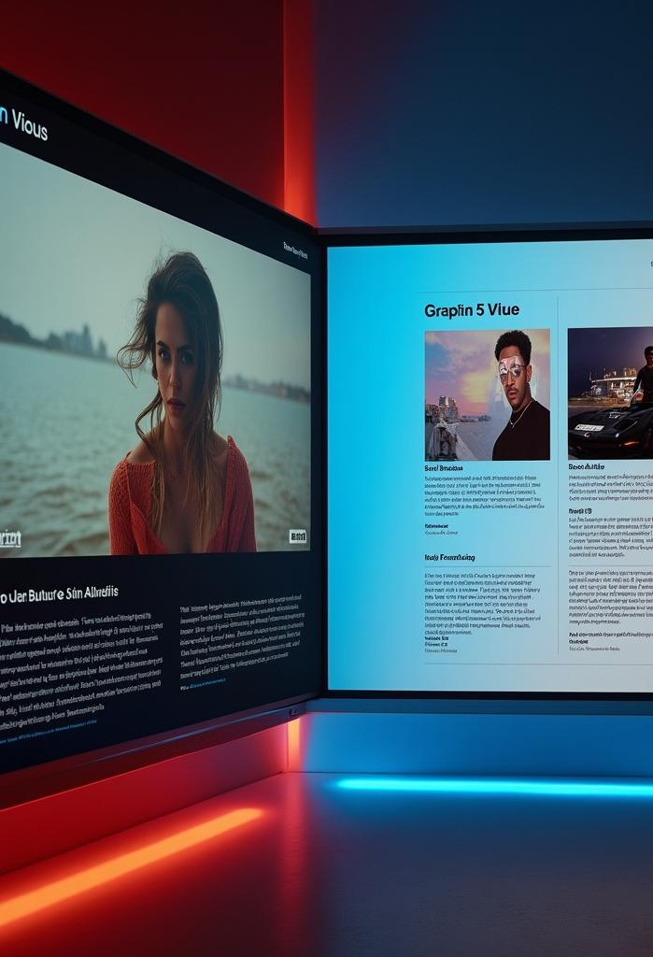
Integration with Albums
The video player will include seamless integration with album sections, allowing users to easily switch between watching music videos and exploring album details. Each video will link back to the respective album page, highlighting track listings, album art, and additional content such as behind-the-scenes videos or interviews with the artists.

Slide 9
Artist Promotion Features
To promote artists effectively, the website will include features such as artist spotlight sections, social media sharing options, and newsletters for fans. This will facilitate greater visibility for upcoming releases and events, helping to build a loyal fanbase while encouraging interaction between artists and their audience.

Slide 10
Conclusions
In summary, the proposed website for the music group will serve as a dynamic platform to enhance user engagement through a specialized song video player, effective album integration, and robust artist promotion features. These capabilities aim to attract and retain a dedicated audience, fostering a vibrant online music community.

Slide 11
Thank you!
Do you have any questions?
+00 000 000 000

